Slide 1
AIRPORT ORGANISATION & MANAGEMETNSYSTEM
POWER POINT PRESENTATION & OVERVIEW OF PROJECT

Slide 2
Index
01
Project Introduction & Overview
02
Technology Used
03
Objective & Scope
04
Future Scope

Slide 3

Welcome!!
AIRPORT ORGANISATION & MANAGEMETNSYSTEM

Slide 4

Project Introduction & Overview
A.O.M.S is the ERP software for operations, resources and airport management based on Visual Basic. This solution includes a set of integrated modules into a unique ERP software.
•Making a system wherein the airport management system is handled much easily
•Reducing the amount of usage on the day to day functioning of the airport.
•Proper flow of data in the system is maintained and no data redundancy is observed in the ERP System.
•By means of this airport management software, users are able to control the company activities, connecting the application to other systems on airports such as booking
and external solutions (airlines, air navigation, etc.)..

Slide 5
A.O.M.S covers these areas
A.O.D.B
R.M.S
Airport Operational Database.
Resource Management System
Billing
Commercial
.
Commercial Flight Management System

Slide 6
Technology Used
Front End
VB 6.0.
Back End
MS Access .
Interface Design
Corel Draw X21.

Slide 7
Objective
A
C
D
E
B
Improve Service Experience
A
Passenger can enjoy hassle free service.
B
Enhance Competitiveness
Competition will led to better service
C
Modernize Business Processes and Systems
D
Automate Business Solutions
Automation in business
E
Increase Operating Efficiency
Faster operational integration.

Slide 8


Scope
A.O.M.S is an integrated software developed of airport operating companies / government. The main aim of this project is to help the airport operating companies / government to manage their customers, flight operating companies and customer. It makes all operations of the airport easy and accurate.
The stand-alone platform makes airport management easy by handling requests and providing services for the customers. Different modules have been incorporated in this product to handle different parts and sectors of the airport management field

Slide 9
Future Scope
Insert the title of your subtitle Here
FUNCTIO-ALITY
PERFORMA-NCE
USUABLITY
REALIBLITY
Any agency can make use of it for saving customer details in database
This application can easily implemented under various situation.
We can add new features as and when we require..
Reusability of this application is also possible..

Slide 10
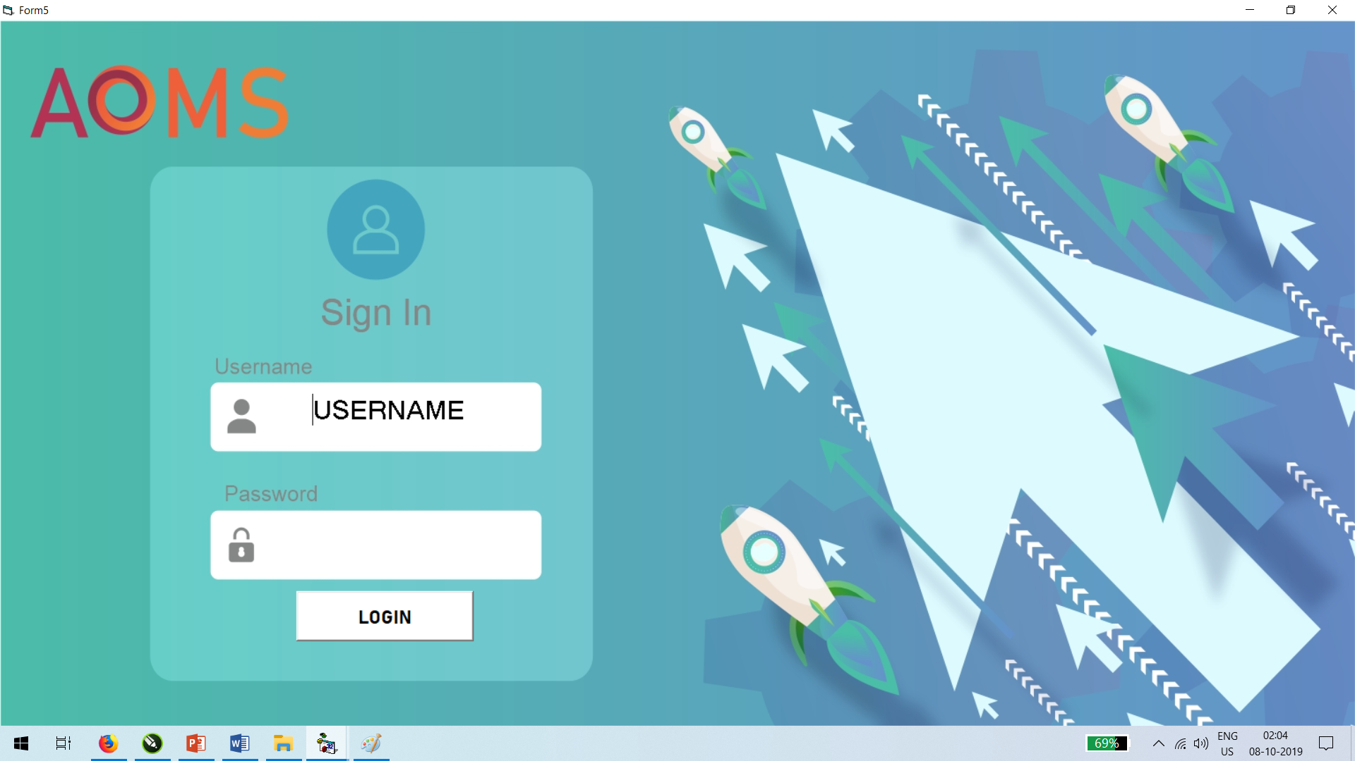
LOGIN FORM
A Login form is used to enter authentication credentials to access a restricted page or form. The login form contains a field for the username and another for the password. ... Like the search form, a login form is basically a record form whose insert, update and delete properties have been disabled.

Slide 11
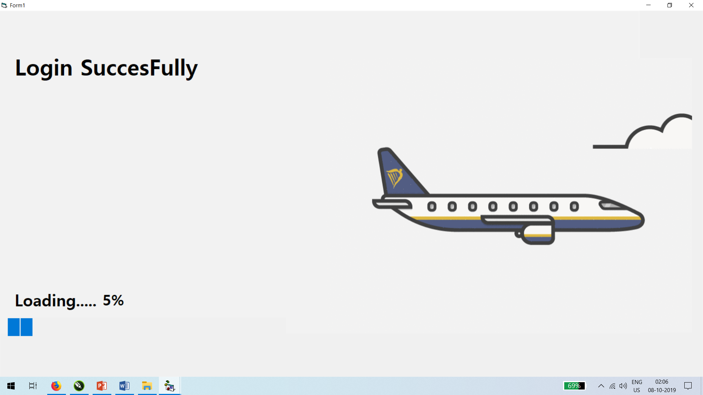
LOADING FORM
Loading form is used to depict the loading of component into the memory.

Slide 12
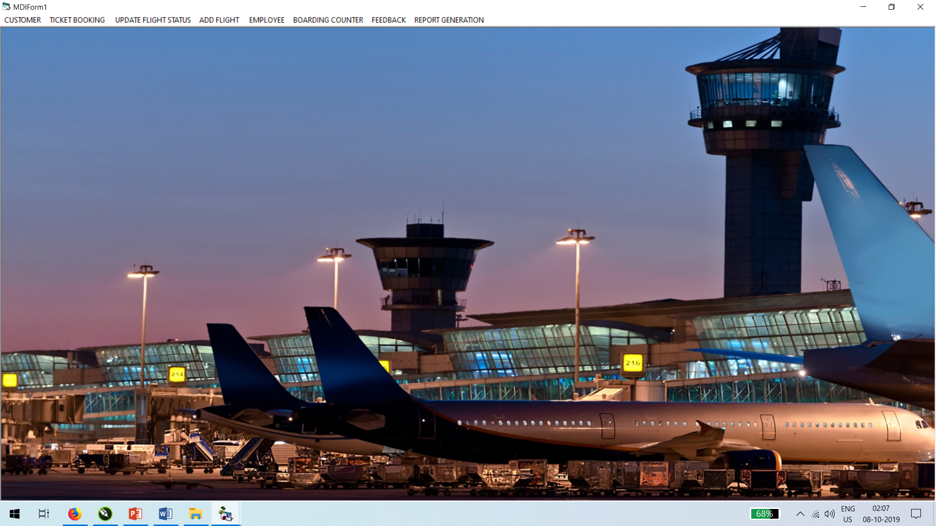
MDI FORM
The Multiple Document Interface (MDI) in Visual Basic 6. The Multiple Document Interface (MDI) was designed to simplify the exchange of information among documents, all under the same roof. With the main application, you can maintain multiple open windows, but not multiple copies of the application.

Slide 13
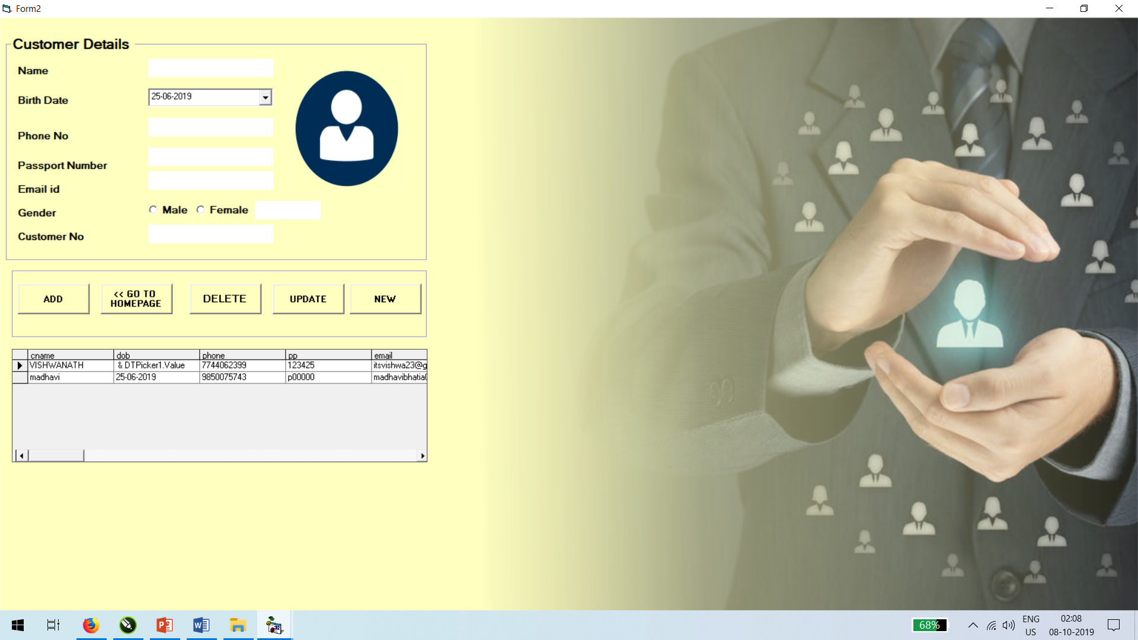
ADD CUSTOMER FORM
Used to add new customer or update existing in the system.

Slide 14
ADD CUSTOMER FORM
Used to add new customer or update existing in the system.

Slide 15
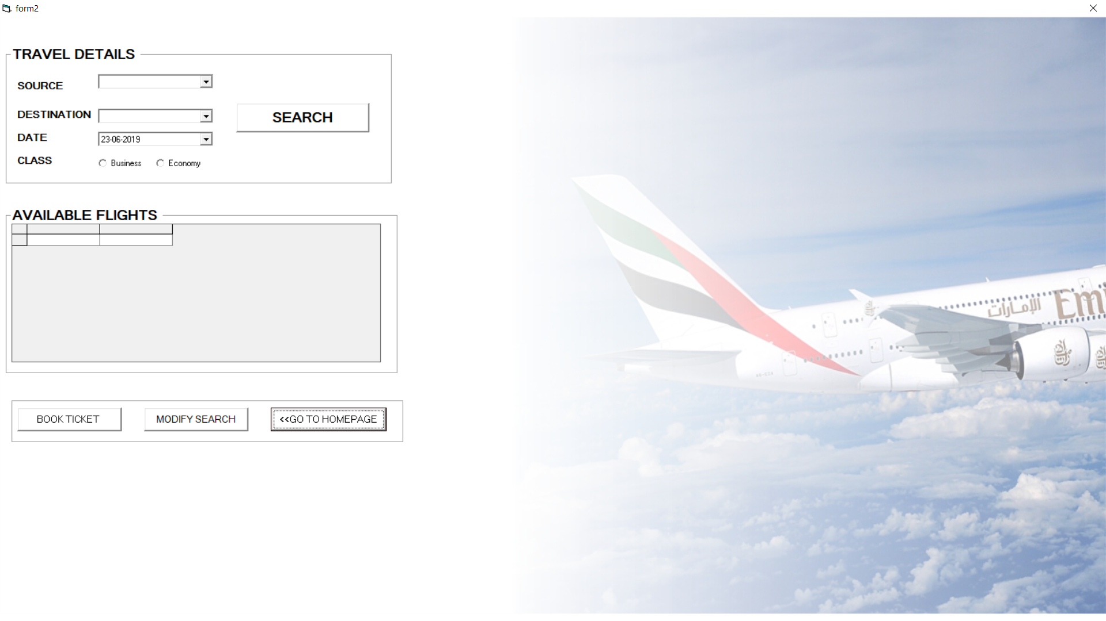

BOOKING FORM
Used to book ticket in the system.

Slide 16
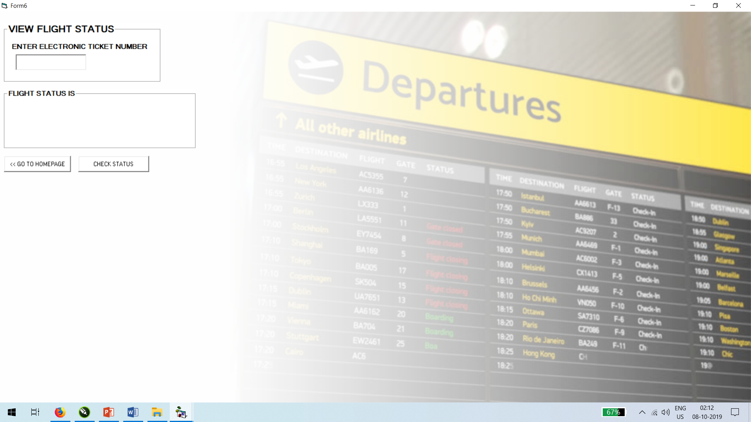
STAUS CHECKING FORM
Used to check flight status in the system.

Slide 17
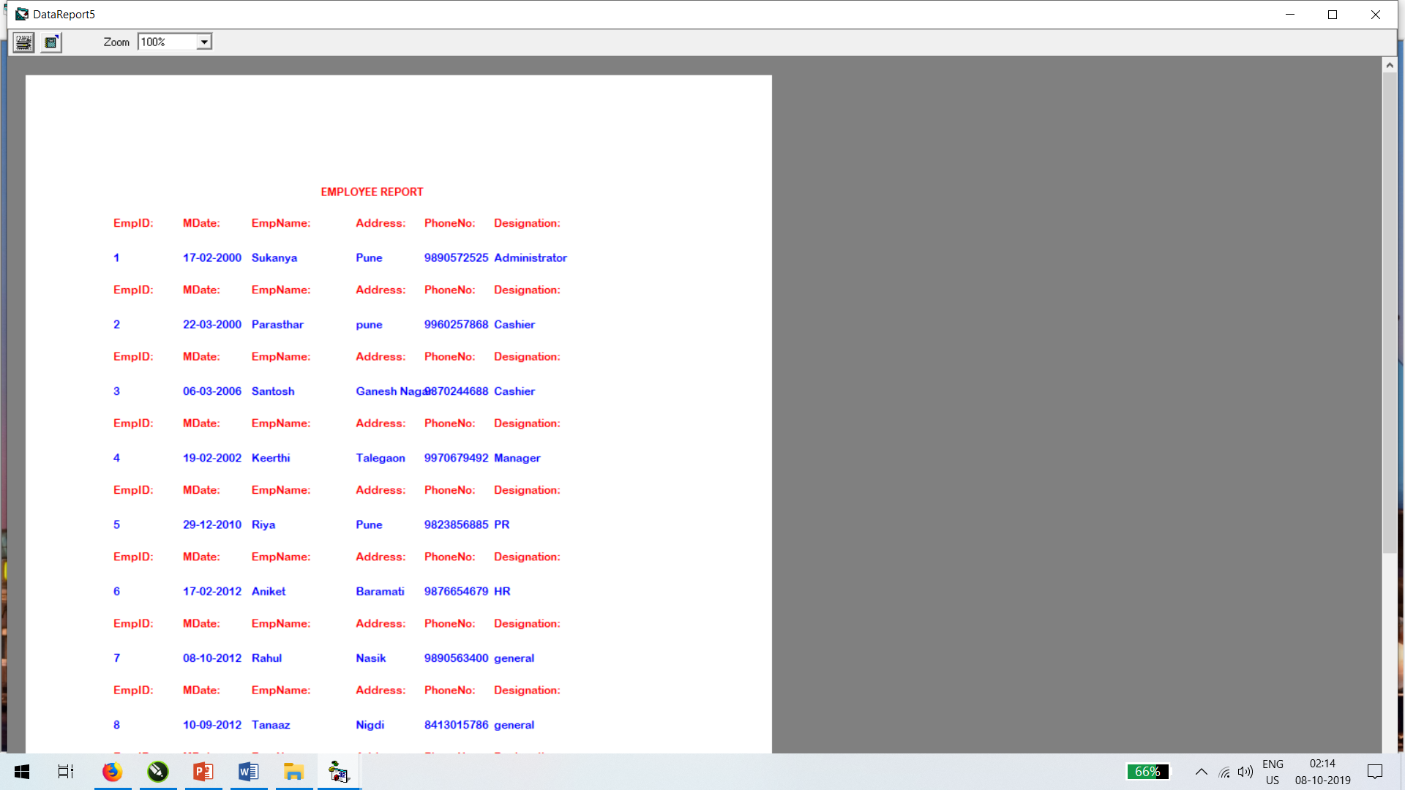
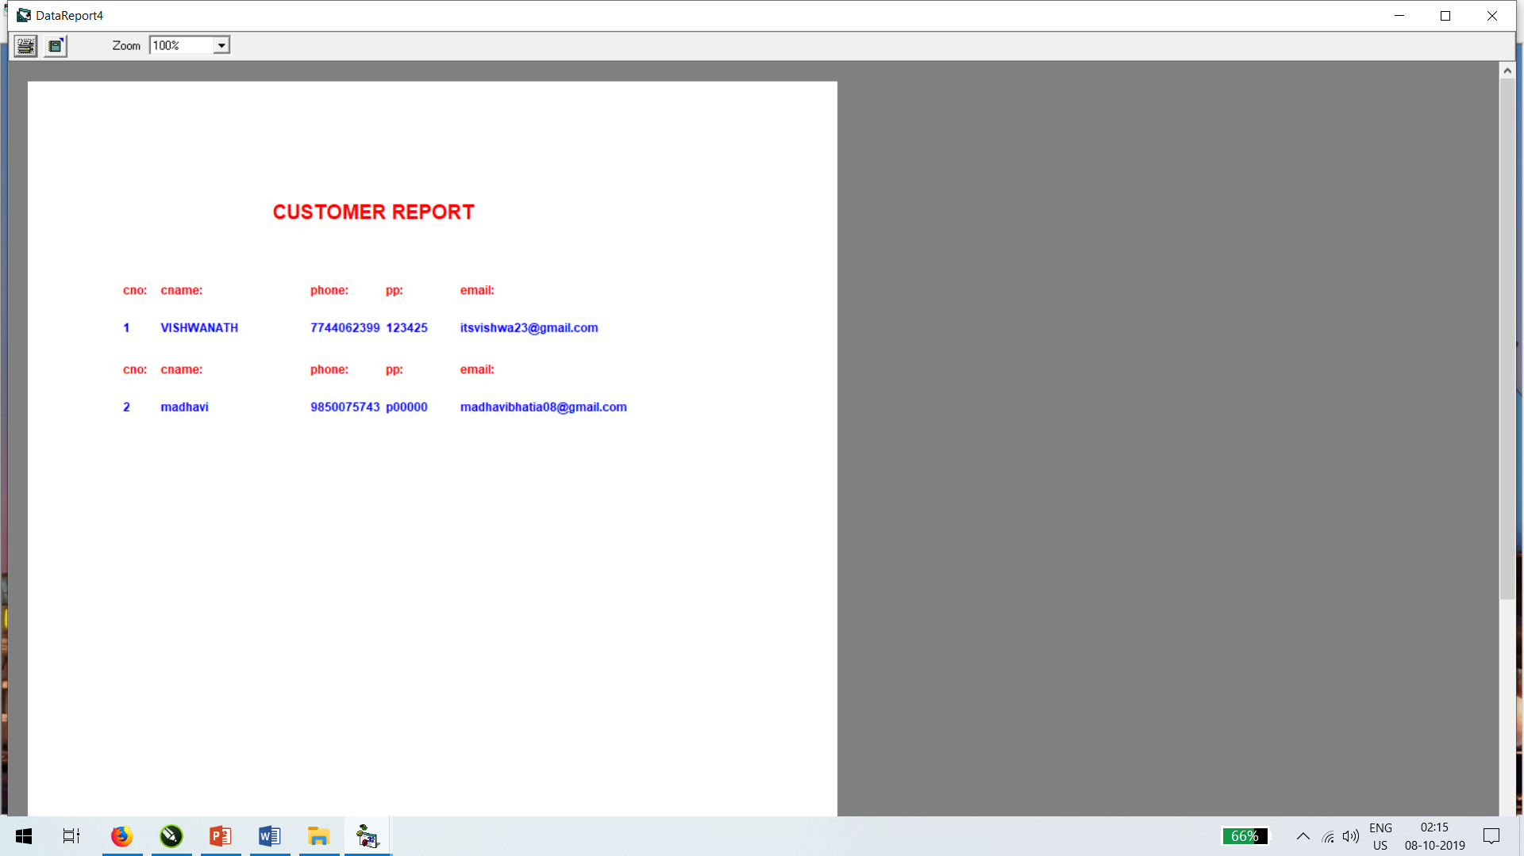
REPORTS

Slide 18
Thank you
Insert the title of your subtitle Here

